Slide 1
Session Hijacking Lab

Slide 2
Session Hijacking Lab
Materials needed
Kali Linux Virtual Machine
Windows 7 Virtual Machine
Software tool used
DVWA (Web Application)

Slide 3
Objectives Covered
Security+ Objectives (SY0-501)
Objective 1.2 – Compare and contrast types of attacks
Application/service attacks
Hijacking and related attacks
Session hijacking
DHS CAE Units
CTH – Describe different types of attacks and their characteristics

Slide 4
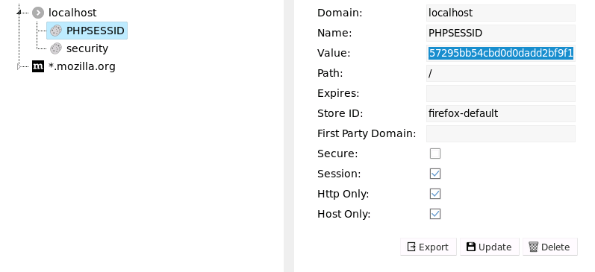
What is a Session Hijacking Attack?
Session hijacking is when an attacker gains access to a legitimate session
Gains access by using the same cookies (especially the session ID cookie)
This is sometimes called cookie hijacking
A hacker authenticates via the same cookies as the normal user

Slide 5
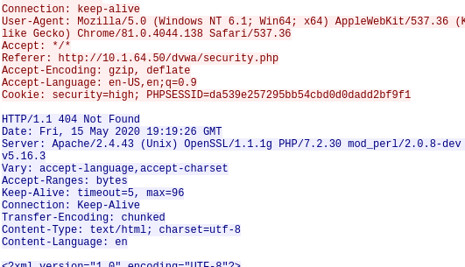
The Session Hijacking Lab
Setup Environments
Find Kali’s IP Address
Log into DVWA
Capture the Session ID
Use the Session ID
Hijack the Session

Slide 6
Setup Environments
Log into your range
Open the Kali Linux and Windows 7 Environments
You should be on your Kali Linux Desktop
You should also be on your Windows 7 Desktop

Slide 7

Find the IP Address (Kali Machine)
You will need the IP address of the Kali machine
Open the Terminal
In the Linux VM, open the Terminal and type the following command:
hostname -I
This will display the IP Address
Write down the Kali VM IP address
The IP Address

Slide 8
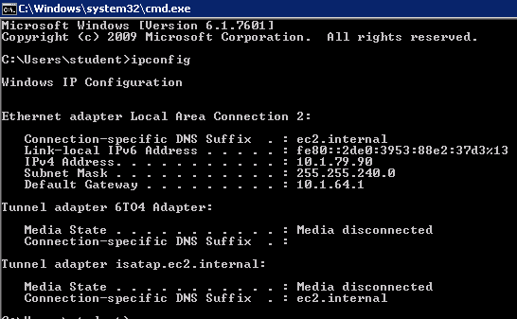
Find the IP Address (Windows Machine)
Select the Start button (Windows Machine) and search for “cmd”
Open cmd (Command Prompt)
Use the following command:
ipconfig
Search for the IPv4 Address line
Write down the Windows IP Address
Windows IP Address

Slide 9
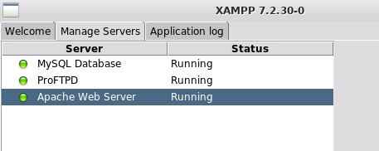
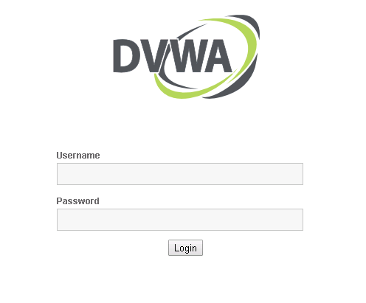
Log into DVWA
Start up the web servers (on the Kali machine)
If you used the DVWA Setup Lab, use the following command to start XAMPP (then start/restart all the servers):
sudo /opt/lampp/./manager-linux-x64.run
On the Windows Machine, go to the DVWA webpage
http://Kali-IP-Address/dvwa
Login using the following credentials
Username: admin
Password: password

Slide 10

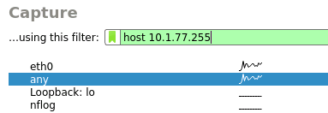

Capture the Session ID
In Kali, open a Terminal
Open Wireshark with the following command
sudo wireshark
In the “…using this filter:” option, type
host <Windows-IP-Address>
This will only find packets from the Windows machine
Select the “any” network below
Click on the blue fin to start capturing packets
Windows IP Address
Select “any” network
Blue fin to start capturing packets

Slide 11
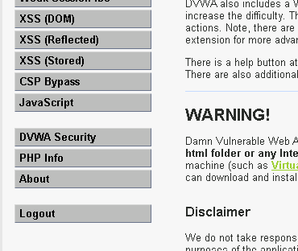
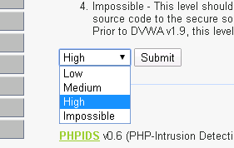
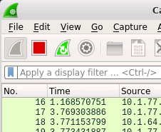
Capture the Session ID
On the Windows 7 machine, change the security to “High”
Click on the DVWA Security tab
On the dropdown menu, change “Impossible” to “High”
Click Submit
On the Kali machine, stop the capture
Click on the red square
Change to “High”
DVWA Security
Stops the capture

Slide 12
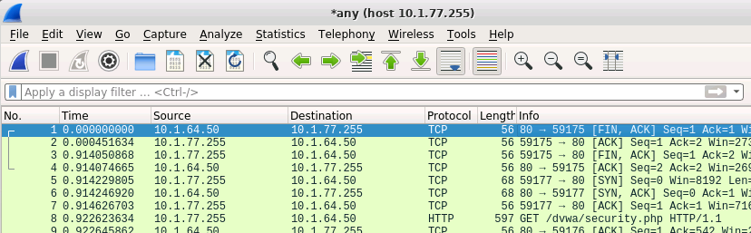
Capture the Session ID
In the packet capture, look for the following HTTP request in Info:
GET /dvwa/security.php
Look for this packet

Slide 13
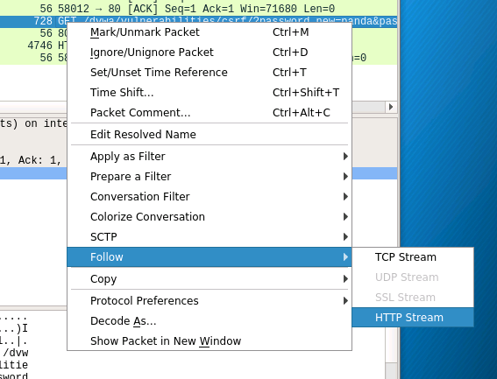
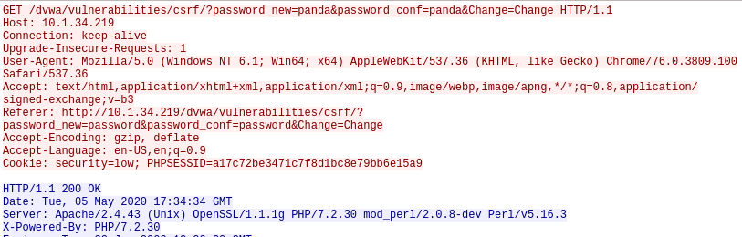
Capture the Session ID
Right-click on the packet
Select the “Follow” option
Select “HTTP Stream”
This will open this HTTP exchange
Follow the HTTP Stream
The HTTP Stream

Slide 14
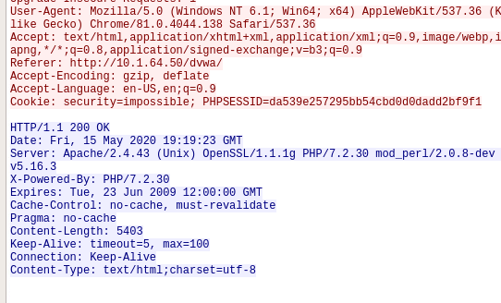
Capture the Session ID
You should see the session ID
Will be in red
You should also see the security=impossible
Scroll down to see when the security changed to high
Copy that session ID
Security set to 'impossible'
Security changed to 'high'
Copy the Session ID

Slide 15
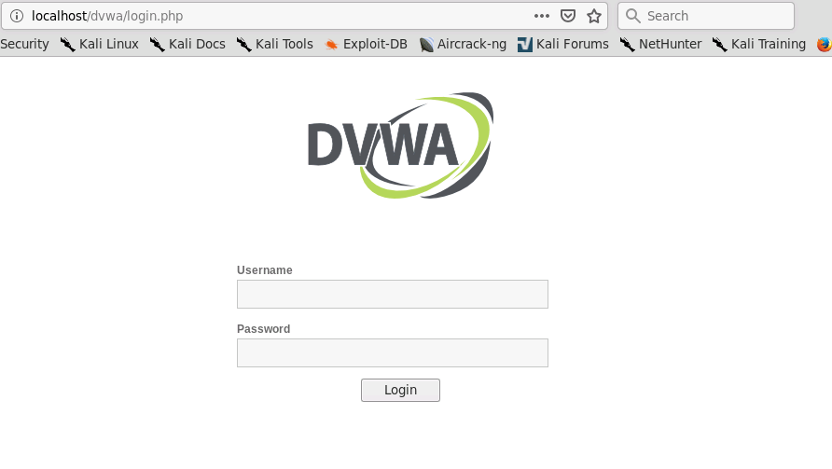
Use the Session ID
In Kali, open Firefox*/web browser
Go to localhost/dvwa
This is the DVWA website
Notice you still have to log-in
Use the captured session ID to login
Not having to log-in
*Use the following command to install Firefox:
sudo apt-get install firefox-esr

Slide 16
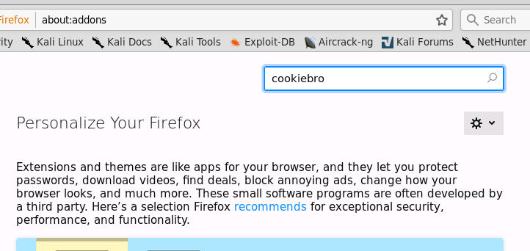
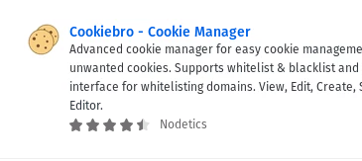
Use the Session ID
To change the session ID, we are going to use the Cookiebro add-on
Open the add-ons
CTRL+SHIFT+A
Search for “cookiebro” in the search bar
Select the extension Cookiebro - Cookie Manager
Click “+ Add to Firefox”
Select “Add” when prompted

Slide 17
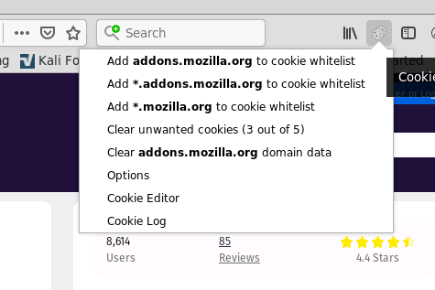
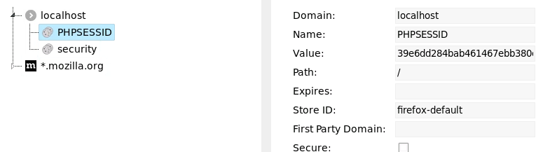
Use the Session ID
Click on the Cookiebro extension
Select “Cookie Editor”
Open localhost settings
You should see “PHPSESSID” and “security”
Click on “PHPSESSID”
Here we can change the Session ID
Cookie Editor
The Session ID

Slide 18
Use the Session ID
Change the PHPSESSID to the copied/captured Session ID
Click update to save the changes (you should see a verification it was updated)
Select the security cookie
Change the “Value:” to our current setting of “high”
Click update to save the changes
Changing the Session ID
Don’t forget to update!

Slide 19
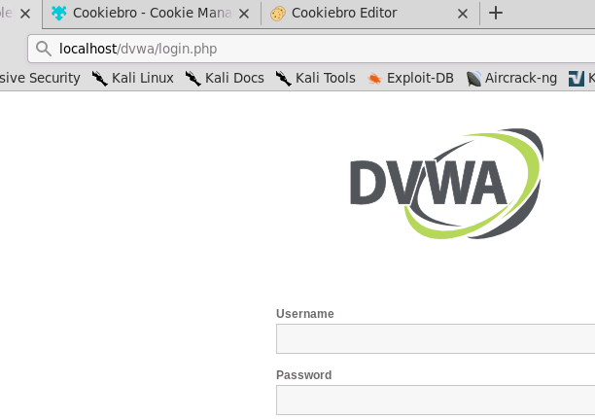
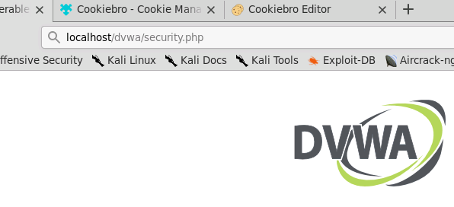
Hijack the Session
Change “login.php” to “security.php”
Click on the DVWA tab in Firefox
Change the URL
Change the login.php to security.php
Load the webpage
Notice you are now logged into DVWA
This is the same session as the Windows session!
You have hijacked the Windows user’s session and never had to find their password or log into DVWA!

Slide 20
Defend Against Session Hijacking
Avoid GET when possible
Do not leave sessions opened
This attack would not have happened if the user was not logged into the DVWA website application on the other tab
Timestamp cookies/sessions
Use SameSite Cookies
Don’t allow cookies to be used on external websites
What are some other ways of defending against a session hijacking?

